Slide 1
Event Management for Clubs & Societies
October 6th 2022
Please note that this workshop is being recorded

Slide 2
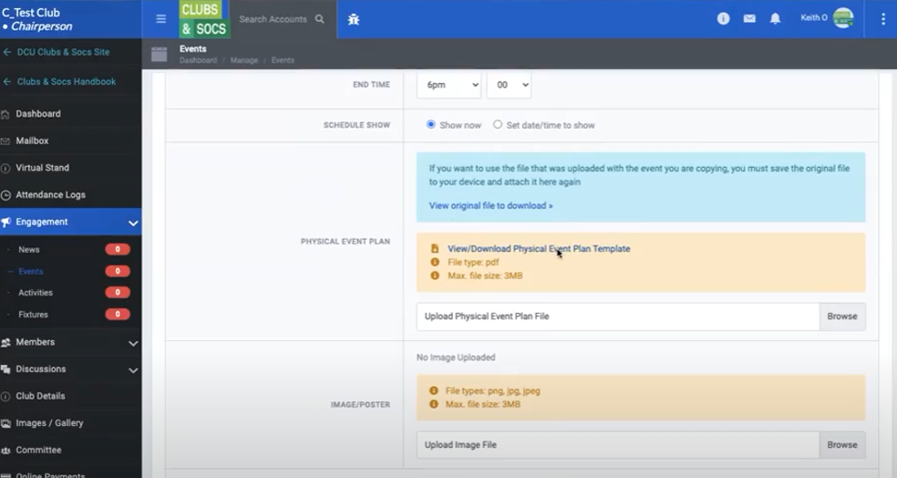
Online Management System
This is where your Club/Society will be uploading your events and activities.
Every Club/Society needs a form, - virtual, activity, event.
Tip! A lot of Societies forget to click the ‘save’ button at the end of their submission.

Slide 3
How do I set up an event?

Slide 4
Set up a meeting with clubsandsocsevents@dcu.ie
1

Slide 5
Complete Event Plan
2
Avoid delays by giving as much detail as possible.
The boring part, but one of the most important parts, is the financial section.

Slide 6
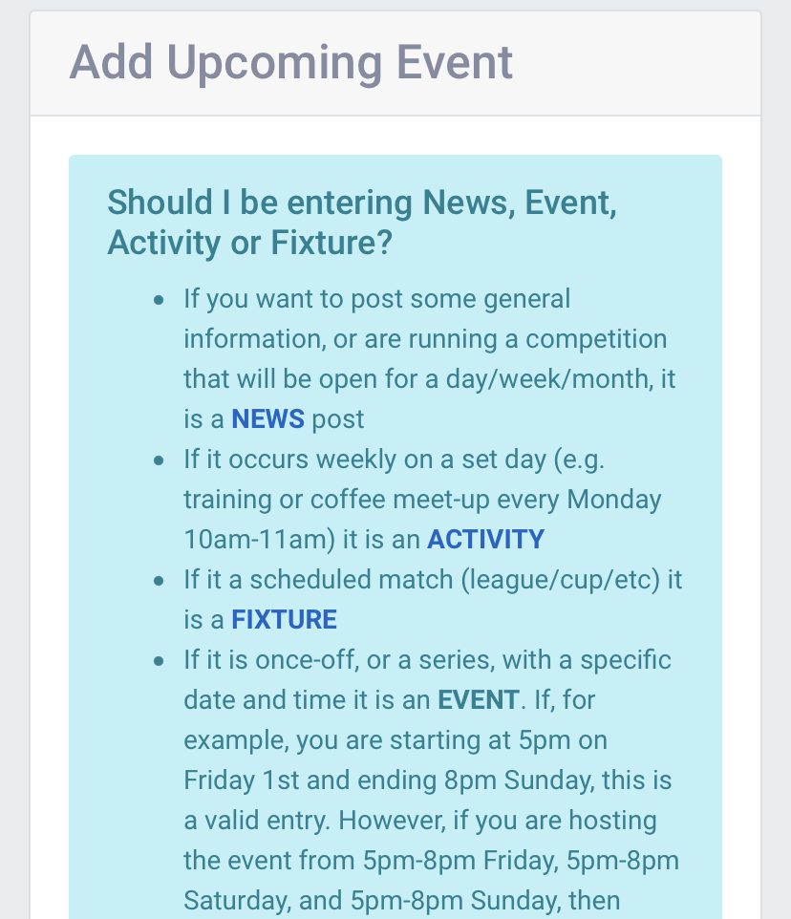
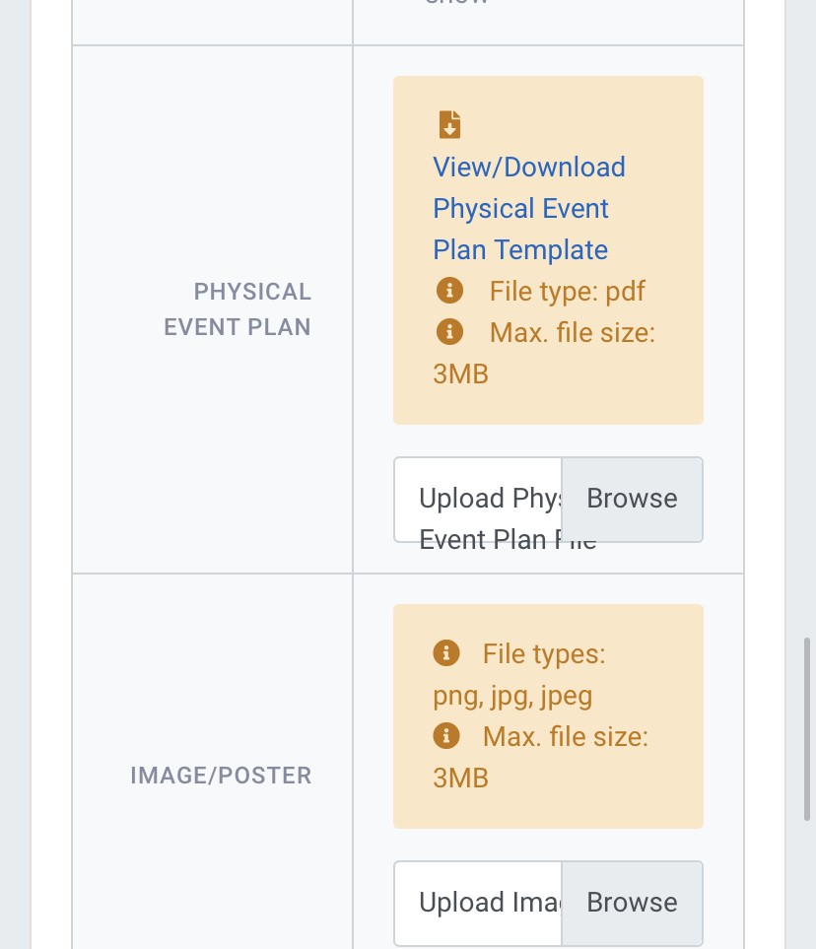
Upload Event Plan
3

Slide 7
Meet with Siobhán & Bláthnaid
4

Slide 8
Once you have gotten your sign-off:
5
Get started with your promotion.
Set up your ticket sales on Ticketsolve.

Slide 9
Summary
Set up a meeting with clubsandsocsevents@dcu.ie
Complete Event Plan
Upload Event Plan
Meet with Siobhán and Bláthnaid
Get started with your promotion

Slide 10
Risk Assessments
Risk Assessments are required for large events or events with a degree of risk.
Eg. A boxing event would have more risk involved than a coffee morning
Smaller events such as EGMS would not require a risk assessment
If you are ever unsure about risk assessments - Email me for clarification!

Slide 11
If you need security or a medic:
Ratio is 1 security per 100 students.
You might need a medic.
C&S Events will book these on your behalf.

Slide 12
Room Bookings
The U’s rooms are bookable on the C&S System.
Room bookings are subject to submission of an event management plan.
Room capacities are listed on the
System too.

Slide 13
Attendance Logs

Slide 14
SU SSHHH!! Logo

Slide 15
Do’s and Don’ts
Do: | Don’t
Get in touch with clubsandsocsevents@dcu.ie | Run an event without getting in touch/uploading an event plan
Complete/upload an event plan | Promote the event until C&S have approved the event
Include “SSHHH!!” Logo on your poster (after 6:00pm events) | Print or put up posters without showing C&S first Sign a contract without showing it to us
Bring your posters to C&S to be stamped
Give lots of notice before an event takes place

Slide 16
EGMs
Get in touch with bookings@dcu.ie (Henry Grattan).
24hrs notice required
Be realistic with expected numbers, and book accordingly.

Slide 17
Event or Activity?
Event
Activity
Once off / Big events
Require a meeting
Often requires a lot promotion
May need to be a ticketed event - ticket solve
Often occurs eg. Committee meetings, coffee mornings, training sessions, rehearsals
Often do not require a meeting

Slide 18
Clubs
Upload your annual risk assessment
Especially if you are a high risk Club!
Upload your fixtures - to avail of funding

Slide 19
How To Organise A Trip
Your trip must be approved in your budget
Set up a meeting with Siobhan and Bláthnaid.
Fill out a Trip Registration Form
Wait For Approval
Book your trip
Max of 25 people Min 10 people for abroad trips
Domestic and Abroad
Please see our C&S Handbook and Policies for more info

Slide 20
Make yourself aware of Policies
All of the university’s policies are available at DCU’s website or in the Clubs and Socs Committee documents section.
Alcohol Policy
Drugs Policy
Sexual Misconduct Policy
These policies are in place to protect you and your members.
Consider these policies when planning an event/activity.

Slide 21
Workshops Available:
Online Management Workshop (Recording)
Consent Training workshop
Bystander intervention programme

Slide 22
Any Questions?

